Slide 1
Introduction to Matlab
Course Title: Data Communication Sessional
Course Code: cse-322

Slide 2
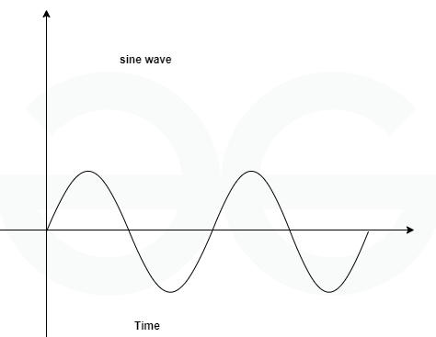
1.Sinusoidal Signal[analog]
y(t) = A sin(2πft+ θ)
clc; clear all; close all;
Fs = 1000;
t = 0:1/Fs:1;
f = 5;
A = 2;
x = A*sin(2*pi*f*t);
plot(t,x);
xlabel('Time (s)');
ylabel('Amplitude');
title('Sinusoidal Signal');
grid on;

Slide 3
In MATLAB, these three commands are used to clear the workspace and command window:
clc:
Clears the Command Window, removing all text and output displayed there.
This is useful for cleaning up the screen and improving readability.
clear all:
Removes all variables from the workspace.
This is helpful when you want to start a new session without any existing variables interfering with your calculations.
close all:
Closes all open figures.
This is useful when you have multiple figures open and want to clear them all at once.
Parameter Definition:
Fs: Sampling frequency determines how many samples are taken per second.
t: Time vector, created using 0:1/Fs:1, spans from 0 to 1 second with steps of 1/Fs.
f: Frequency of the sinusoidal signal.
A: Amplitude of the sinusoidal signal.

Slide 4
Plotting the Signal:
plot(t,x): Plots the signal x against time t.
xlabel, ylabel, and title: Add labels to the x-axis, y-axis, and the plot title, respectively.
grid on: Turns on the grid lines for better readability.

Slide 5
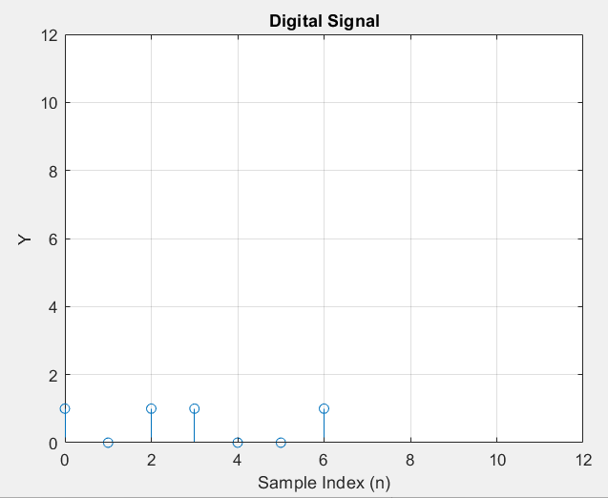
2. Digital Signal in MATLAB
clc; clear all; close all;
x = [1 0 1 1 0 0 1];
n = 0:length(x)-1;
stem(n, x);
axis([0 12 0 12]);
xlabel('Sample Index (n)');
ylabel('Amplitude');
title('Digital Signal');
grid on;

Slide 6
Defining the Signal: We create a vector x to represent the digital signal. Each element in x corresponds to a sample of the signal. Creating the Time Vector: The n vector represents the sample indices, starting from 0.
Plotting the Signal: stem(n, x): This command creates a stem plot, where the vertical lines represent the amplitude of each sample at the corresponding time index.
Adding Labels: xlabel, ylabel, and title are used to label the x-axis, y-axis, and the entire plot, respectively.
Customizing the Plot:
grid on: This command adds a grid to the plot for better readability.

Slide 7
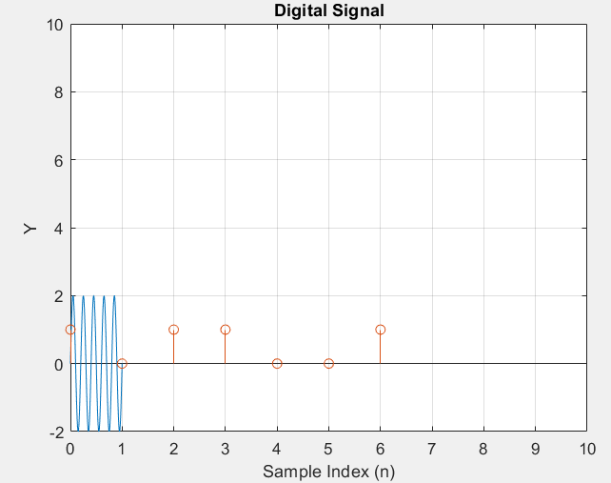
3.Use of hold
clc; clear all; close all;
%For analog signal
Fs = 1000;
t = 0:1/Fs:1;
f = 5;
A = 2;
x = A*sin(2*pi*f*t);
plot(t,x);
xlabel('Time (s)');
ylabel('Amplitude');
title('Sinusoidal Signal');
grid off;
hold on;
%For digital Signal
x = [1 0 1 1 0 0 1];
n = 0:length(x)-1;
stem(n, x);
axis([0 10 0 10]);
xlabel('Sample Index (n)');
ylabel('Y');
title('Digital Signal');
grid on;

Slide 8
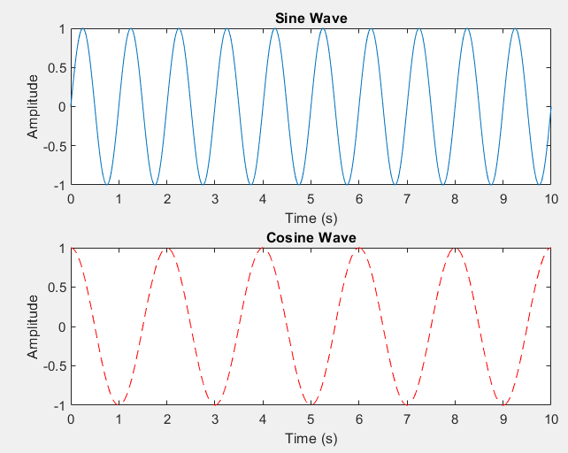
4.Use of subplot[two]
clc; clear all; close all;
t = 0:0.01:10;
x1 = sin(2*pi*t);
x2 = cos(2*pi*t/2);
subplot(2,1,1);
plot(t, x1);
xlabel('Time (s)');
ylabel('Amplitude');
title('Sine Wave');
subplot(2,1,2);
plot(t, x2, 'r--');
xlabel('Time (s)');
ylabel('Amplitude');
title('Cosine Wave');

Slide 9
Explanation:
subplot(2,1,1); divides the figure into a 2x1 grid and selects the first subplot.
subplot(2,1,2); selects the second subplot.
The plot commands in each subplot plot the respective signals.
plot(t, x2, 'r--');
In this MATLAB code, 'r--' is a format string that specifies the color and line style of the plot.
r: This specifies the color of the line, which is red.
--: This specifies the line style, which is a dashed line.
So, 'r--' tells MATLAB to plot the data with a red dashed line.
plot(x, y1, 'b--'); % Blue dashed line
plot(x, y2, 'r:'); % Red dotted line
plot(x, y3, 'g-.'); % Green dash-dot line

Slide 10
Here are some common color and line style formats you can use in MATLAB's plot function:
Colors:
b: Blue
g: Green
r: Red
c: Cyan
m: Magenta
y: Yellow
k: Black
w: White
Line Styles:
-: Solid line (default)
--: Dashed line
:: Dotted line
-.: Dash-dot line
Combining Color and Line Style:
You can combine color and line style in a single format string:
b--: Blue dashed line
r:: Red dotted line
g-.: Green dash-dot line

Slide 11
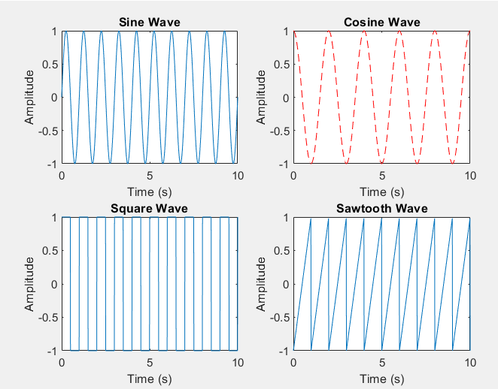
5.Use of subplot[four]
Task-
Draw 6 analog signal using subplot

Slide 12
Use of subplot[four]
% Plot the second signal in the top-right subplot
subplot(2,2,2);
plot(t, x2, 'r--');
xlabel('Time (s)');
ylabel('Amplitude');
title('Cosine Wave');
% Plot the third signal in the bottom-left subplot
subplot(2,2,3);
plot(t, x3);
xlabel('Time (s)');
ylabel('Amplitude');
title('Square Wave');
% Plot the fourth signal in the bottom-right subplot
subplot(2,2,4);
plot(t, x4);
xlabel('Time (s)');
ylabel('Amplitude');
title('Sawtooth Wave');
% Time vector
t = 0:0.01:10;
% Four different signals
x1 = sin(2*pi*t);
x2 = cos(2*pi*t/2);
x3 = square(2*pi*t);
x4 = sawtooth(2*pi*t);
% Create a new figure
figure;
% Plot the first signal in the top-left subplot
subplot(2,2,1);
plot(t, x1);
xlabel('Time (s)');
ylabel('Amplitude');
title('Sine Wave');

Slide 13
Task: Plot Signals in Different Figure

Slide 14
6.Signal Operations: Addition and Subtraction:
t = 0:0.01:10;
x1 = sin(2*pi*5*t);
x2 = cos(2*pi*3*t);
x3 = x1 + x2;
x4 = x1 - x2;
plot(t,x1,t,x2,t,x3,t,x4);
legend('x1','x2','x1+x2','x1-x2');
Task:
1. Draw 1 sine wave, 1 cos wave and 1 addition of these two-wave using subplot
2. Draw 1 sine wave, 1 cos wave and 1 subtract of these two-wave using subplot

Slide 15
7.Multiplication and Division:
t = 0:0.01:10;
x1 = sin(2*pi*5*t);
x2 = cos(2*pi*3*t);
x3 = x1 .* x2;
x4 = x1 ./ x2;
plot(t,x1,t,x2,t,x3,t,x4);
legend('x1','x2','x1*x2','x1/x2');
Task:
1. Draw 1 sine wave, 1 cos wave and 1 multiplication of these two-wave using subplot
2. Draw 1 sine wave, 1 cos wave and 1 division of these two-wave using subplot

